Slide 1
House Price Prediction Project
By: Tomas H, Rita E, Sandra N, Ihechi D

Slide 2
Agenda
Reasons for Chosen Topic
Questions We Plan to Answer
Dataset Description
Tools & Technologies
Data Exploration Phase
Model 1 Analysis & Results
New Models Analysis & Results
Future Analysis Recommendations
Areas of Improvement
Dashboard
Q&A

Slide 3
Why did we choose this topic?
Hot topic!🔥
The housing market is widely talked about, especially since the start of the COVID-19 pandemic.
Impact
We are all impacted by the housing market in one way or another so this is an important topic for us.

Slide 4

Questions we plan to answer
How accurately can a model predict the sale price of a house?
What are the most important features that can impact the price of a house?

Slide 5
Dataset Used: Real dataset of house prices sold in Seattle, Washington, USA between August and December 2022
Seattle, Washington

Slide 6
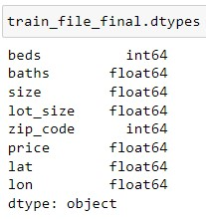
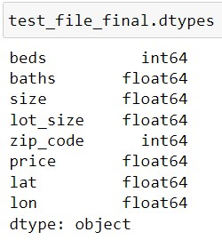
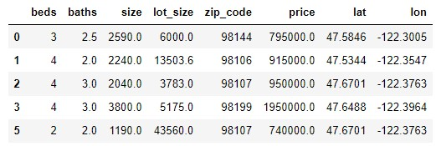
Dataset Description
First dataset: Well-structured testing and training CSV files from Kaggle (dataset link)
8 columns: ‘beds’, ‘baths’, ‘size’, ‘size_units’, ‘lot_size’, ‘lot_size_units’, ‘zip_code’, and ‘price’
Target column is ‘price’, and all other columns are the features
Second dataset: All zip codes in the United States with their coordinates (dataset link)
Used VLOOKUP in Excel to find the corresponding coordinates (‘lat’, ‘lon’) from the second dataset to the zip code in the first dataset (testing and training files)
File was then merged with the testing and training files using Pandas to create the final Data Frame

Slide 7


Tools & Technologies
Visualization: Tableau, Seaborn, Matplotlib, Flask
Data Analysis: Jupyter Notebook, Excel
Algorithms: Linear Regression, Random Forest Regression, k-Nearest Neighbours (k-NN)

Slide 8
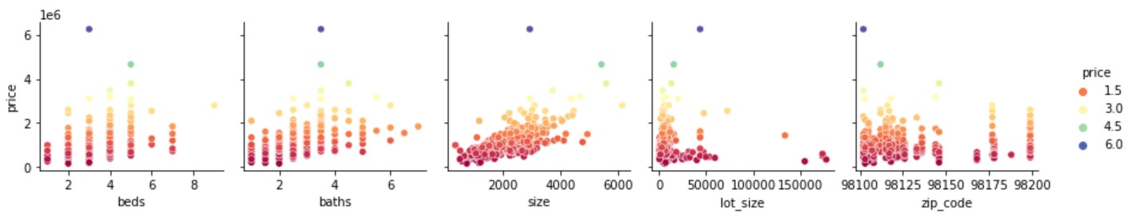
Data Exploration Phase
Using Seaborn, we were able to gather insights on the relationships between factors by creating different types of diagrams.
Pairplot
Diagrams showing price against the different features.

Slide 9
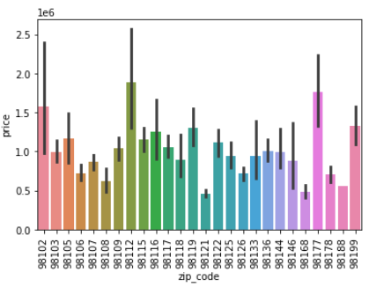
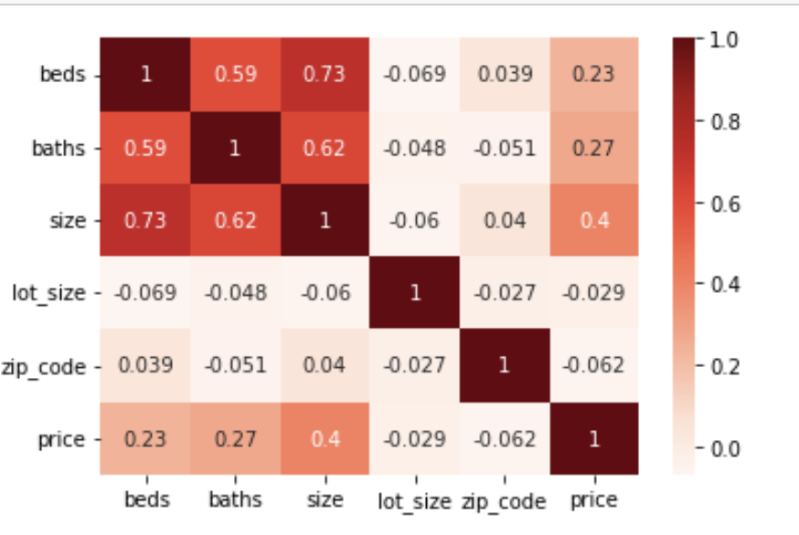
Data Exploration Phase Cont.
Bar Plot
Heatmap
Bar plot illustrating the relationship between price and zip codes.
Heatmap showing correlations between each of the features.

Slide 10
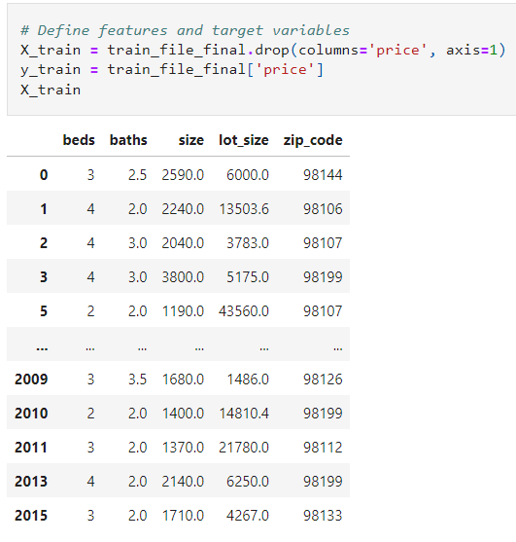
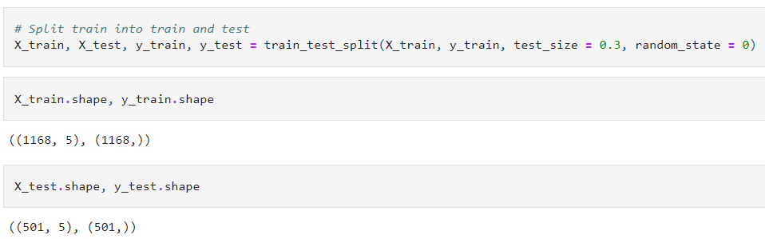
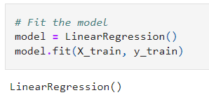
Model 1: Analysis Phase
1.
Since we already had the test and train data CSV files, we performed the following steps:
Defined the features and target variables
Split the train and test data
Fitted the model
2.
3.

Slide 11
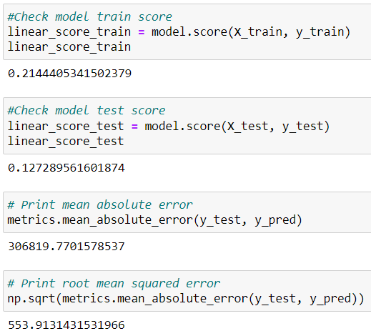
Model 1: Results
We found that the most important feature is the zip code followed by the house size.
Our linear regression model performed poorly with a train score of 21% and a test score of 13%.
The mean absolute error (MAE) was also very high with a score of 306819.77 and a root mean squared error (RMSE) of 553.91.
While we were not satisfied with these results, we achieved our initial goal of building a simple functioning model.

Slide 12
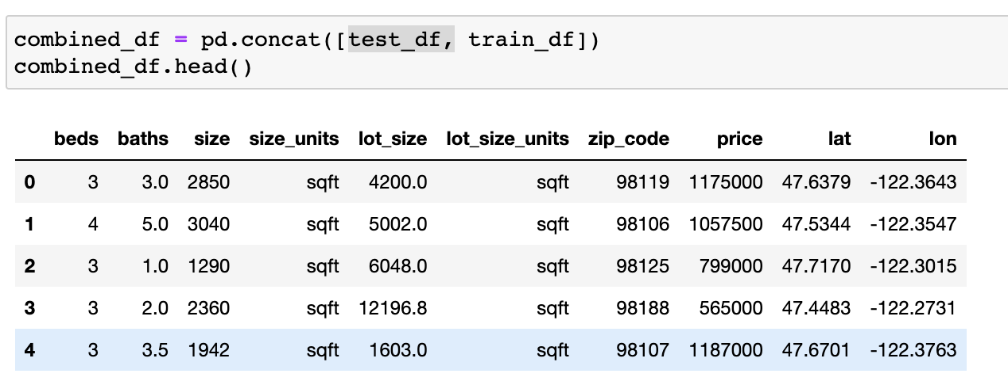
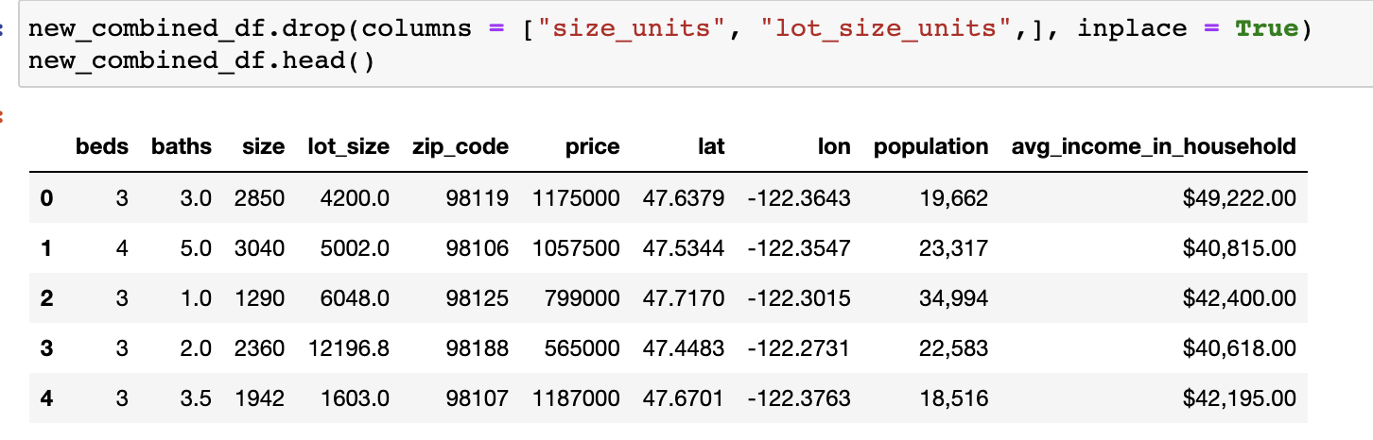
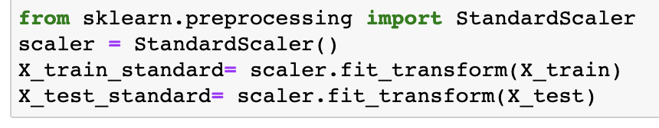
New Models: Analysis Phase
1.
We made the following changes to help improve the model:
Combining the train and the test data frame to create our own split for the model.
New features were added: Population and Average Income Per Household.
The X values of the data were scaled.
2.
3.

Slide 13
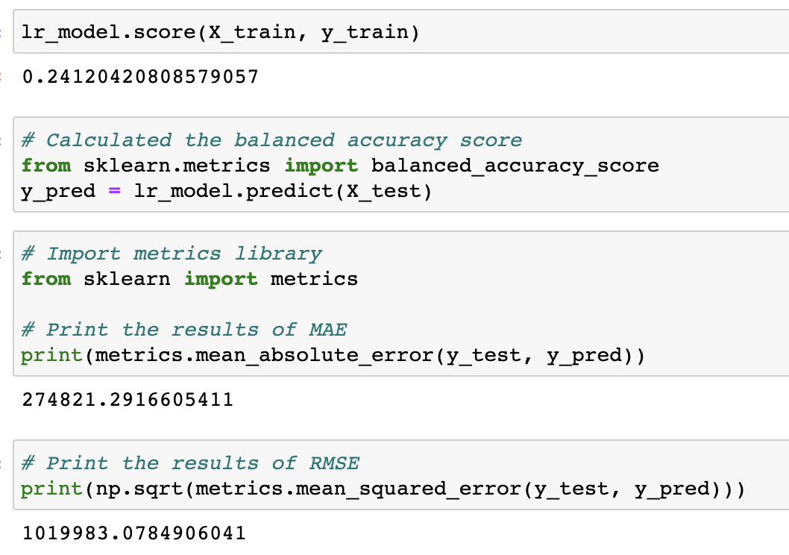
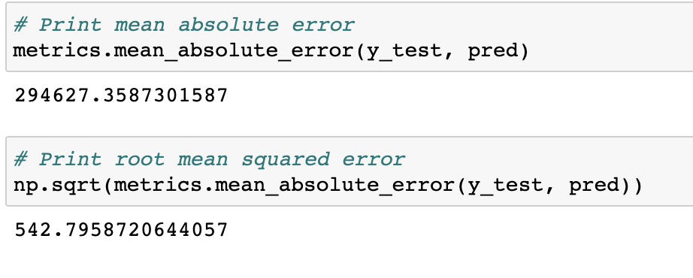
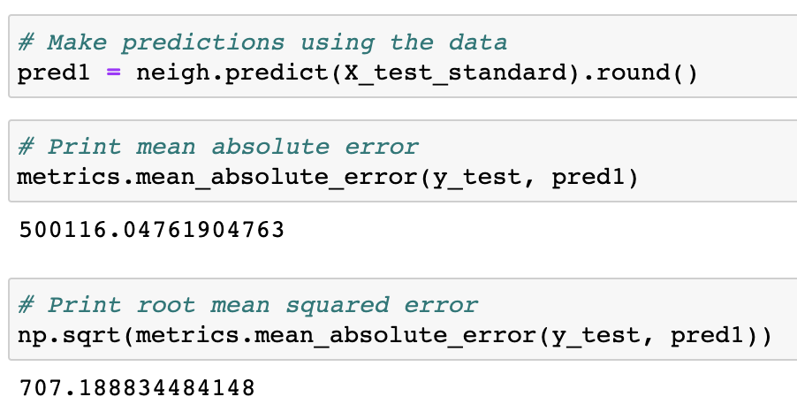
New Models: Results
1.
Linear Regression model: the model score was 24%. The MAE was 274821 and the RMSE was 1019983. This is a poor result but it is a modest improvement compared to the result of our first model.
Random Forest model: the MAE was 294627 and the RMSE was 543.
KNN Regression model: the MAE was 500116 and the RMSE was 707.
2.
3.
By adding new features and testing different models, we successfully improved the model results.

Slide 14
Future Analysis Recommendations
Testing and comparing newer models to find the best results.
Evaluating the model using multiple train/test split to improve performance.
Combining different models instead of using a single model.
Evaluating the performance of the model by adding and removing different features.

Slide 15
Areas of Improvement
Continue developing the model to achieve a higher accuracy score.
Build a more complex Tableau dashboard with more diagrams.
Adding/dropping more features based on importance for the model.
Using a different dataset that is larger and contains a longer time span.

Slide 16
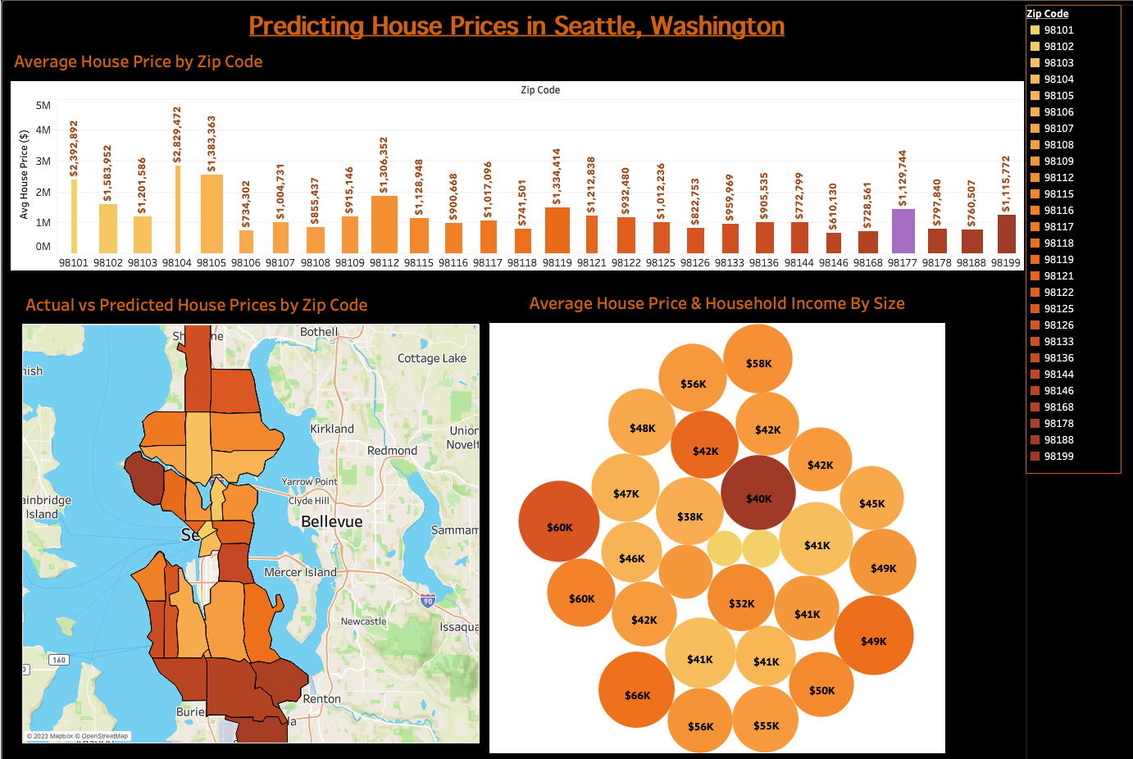
Dashboard
Dashboard Link

Slide 17
THANKS!
Any questions?

